Slide 1


Mixed model effects
Maximo Nores Allende: Master’s student
Elvis Elli: Advisor

Slide 2
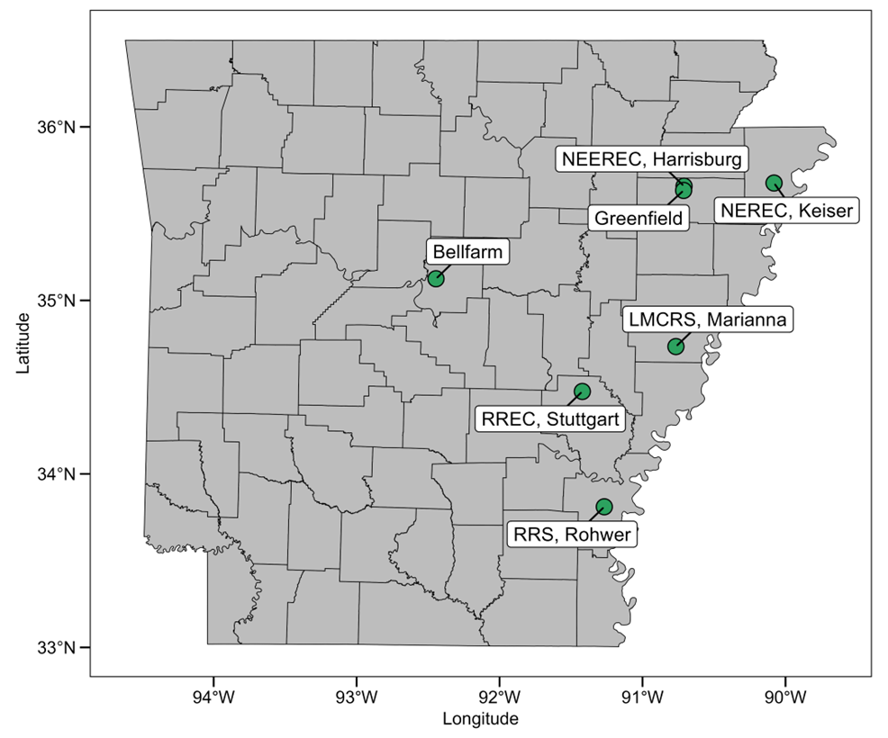
Corn Database
14 years (2010-2023): almost 5000 datapoints
7 locations
~70 hybrids per year
Complete randomized block design (4 reps)
Relative maturity ranging from 103 to 121
One sowing date per year/location (several in total)
Management practices followed UARK recommendations (irrigation, fertilization, pest control)
Soil info: textural class 1 for each location
Weather info: Nasa power

Slide 3
Objectives:
Analyze which variables are driving yields the most
Provide accurate recommendations to farmers regarding planting date and hybrid relative maturity for each environment

Slide 4
Variables:
Database: sowing date, precipitation (per month and total), relative maturity, location, yield, soil textural class, row spacing
Nasa power (from planting to harvest): mean of maximum Temperature, mean of minimum Temperature, cumulative radiation, number of days temperature above 32C

Slide 5
Correlation matrix

Slide 6
Eemeans function to better understand trends

Slide 7
Eemeans Sowing date/Location
model.a.keiser <- lmer(Yield.bu.acre ~ SowingdateDOY + (1 | Hybrid) + (1 | Year), data = data_clean.keiser)

Slide 8
Eemeans Relative Maturity/Location
model.a2.keiser <- lmer(Yield.bu.acre ~ CRM + (1 | Hybrid) + (1 | Year), data = data_clean.keiser)

Slide 9
Challenges:
Which variables should be considered fixed and which as random and why. (hybrid and year were considered random as their specific effect on yields was not of interest)
Minimize multicollinearity: weather data and location are highly correlated
Variables that are positively correlated in some locations, may have a negative effect on yields in other.
Example= Using lme4 package in R, function lme
model_final <- lmer(relative_yield ~ CRM * SowingdateDOY + Location * SowingdateDOY + Year * SowingdateDOY + CRM * Location + row_spacing + (1 | Hybrid), data = data_clean1)

